Slide 1
Phylosophy
Notes:
Unfortunately I do not have access to the slide contents, so I am unable to summarize it or provide teaching notes. If the slide is provided, I would be happy to create helpful summaries and suggestions to assist a teacher in effectively communicating the material to their students. Please let me know if the slide or presentation becomes available.

Slide 2
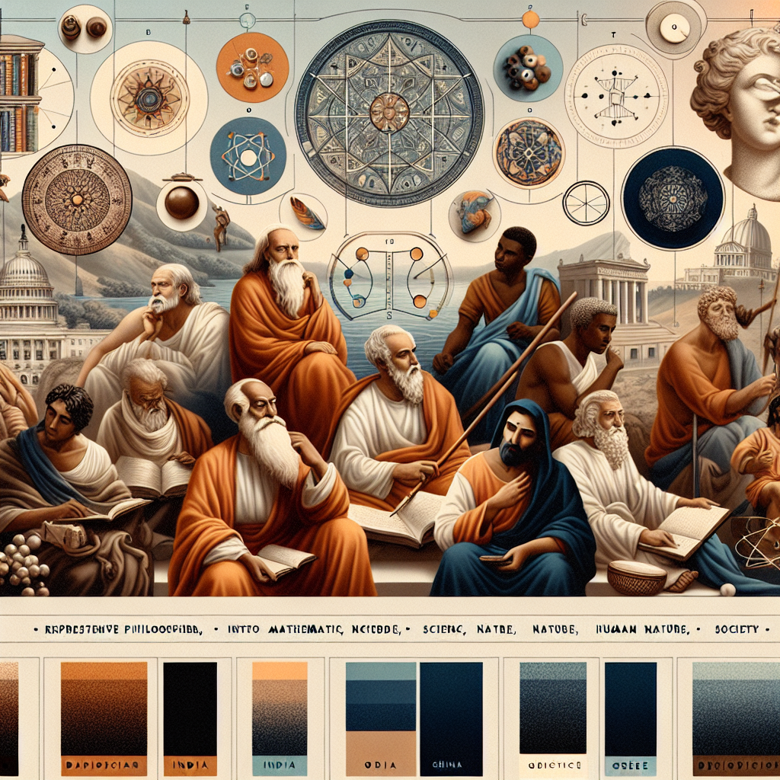
The Early Philosophers - The Sages - Sages were early thinkers who questioned traditions and applied reason to understand the world - They made discoveries in math, science, nature, human nature and society - Examples from India, China, Africa and Greece
Notes:
Here are suggested teacher notes for delivering the content on this slide: Notes: - Introduce the sages as some of the first philosophers and critical thinkers who questioned existing beliefs and applied logic and reason to understand the world around them - Explain that they made important early discoveries in mathematics, science, nature, human behavior, and society that shaped future knowledge - Provide examples of influential sages from various ancient cultures - In India, sages questioned spiritual traditions and developed ideas about the self, consciousness, and reincarnation; In China, Confucian philosophers focused on ethics, good governance and social harmony; Ancient Egypt had scholar Imhotep who made advances in medicine, engineering and architecture; Greek philosophers like Socrates, Plato and Aristotle developed theories on logic, justice, beauty and the purpose of life Student Exercises: - Ask students to research a sage from India, China, Africa or Greece and share a discovery or influential idea they had - Have a discussion comparing the questions or problems different sages from various cultures were trying to solve or understand

Slide 3
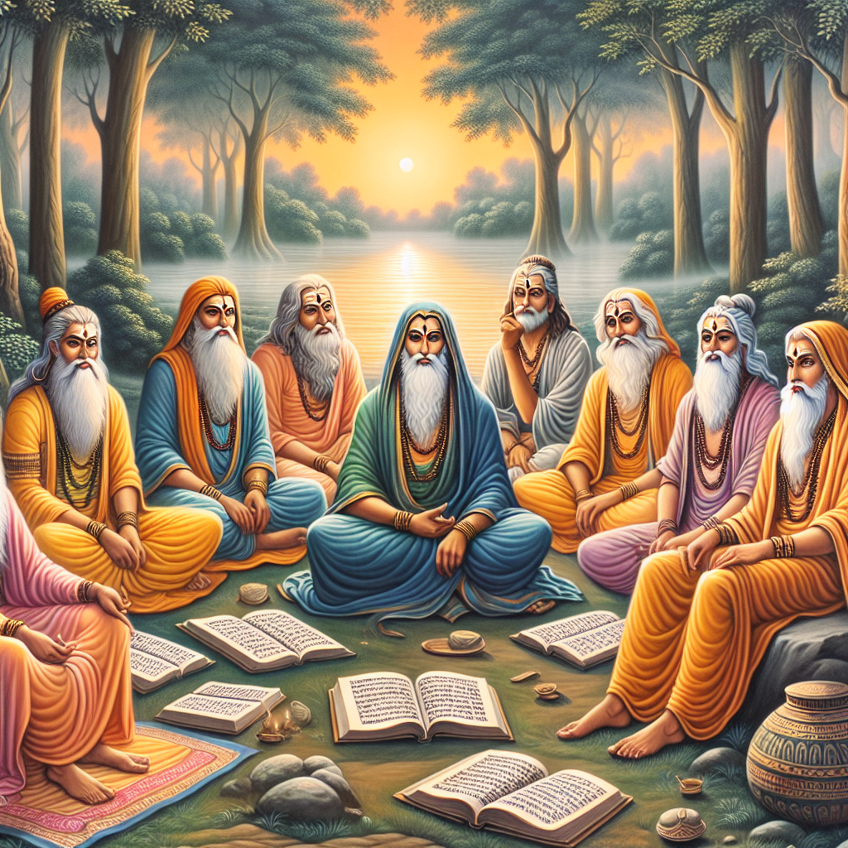
Indian Sages - The Seven Rishis - Partly mythical figures, authors of ancient Indian texts (Vedas) - Lived ascetic lives, gained wisdom through spiritual practices - Passed teachings down through generations - Some women sages made contributions (Ghosha, Maitreyi, Gargi)
Notes:
Here are some suggested notes to help a teacher effectively communicate the content on the slide about Indian Sages to a class of 35-year-old students: The Seven Rishis were partly mythical figures who were believed to be the authors of ancient Indian texts known as the Vedas. - They lived ascetic lifestyles and gained wisdom through intense spiritual practices like meditation. - Their teachings were passed down orally from generation to generation for centuries. There were also some renowned women sages who made important contributions to ancient Indian philosophy and spirituality, like: - Ghosha - a poet sage - Maitreyi - known for her philosophical dialogues - Gargi - respected Vedic philosopher Discussion questions: - Why might the sages have lived ascetic lifestyles? What did this allow them to achieve? - What methods might have been used to pass down teachings from one sage to the next over generations? - Why is it significant that we know of contributions from women sages like Ghosha, Maitreyi, and Gargi?

Slide 4
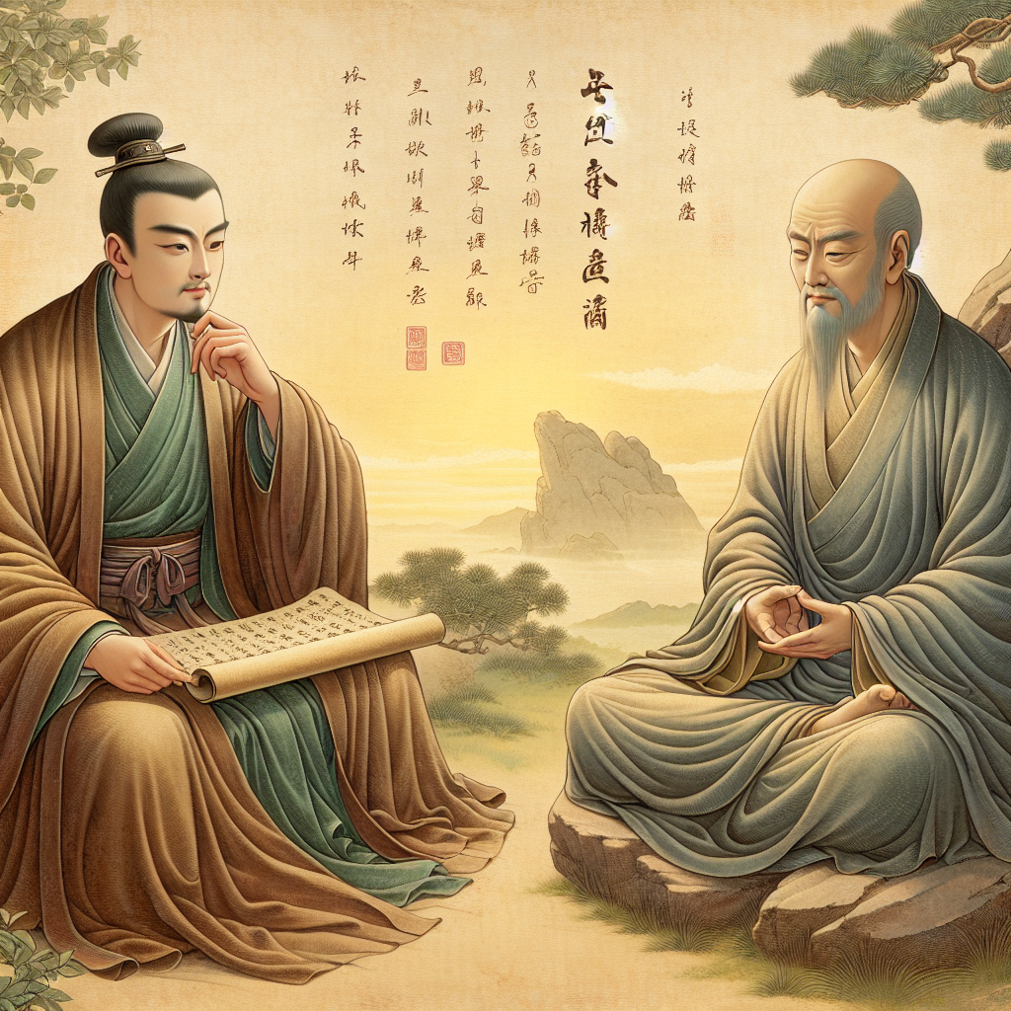
Chinese Sages - Confucius - focused on ethics, justice, social harmony - Laozi - founded Taoism, the "Way" of nature & simplicity - Their teachings became influential philosophical traditions
Notes:
Here are suggested teacher notes for the slide on Chinese Sages: Notes: - Briefly explain who Confucius was and his core teachings about ethics, justice, and social harmony. Give examples of Confucian values. Ask students to reflect on how these values continue to shape Chinese culture. - Introduce Laozi as the founder of Taoism. Explain the Taoist emphasis on living in harmony with nature and valuing simplicity. You may ask students to consider how Taoist thought differs from and complements Confucianism. - Contextualize how both Confucian and Taoist philosophies became highly influential traditions that have shaped Chinese history and culture up to modern times. Ask students to think about examples of how they see the legacy of these schools of thought today. - As an exercise, you could divide the class into small groups and assign each group to further research either Confucianism or Taoism using classroom resources. Have them share back key learnings. Let me know if you need any clarification or have additional suggestions for presenting this content on Chinese sages.

Slide 5
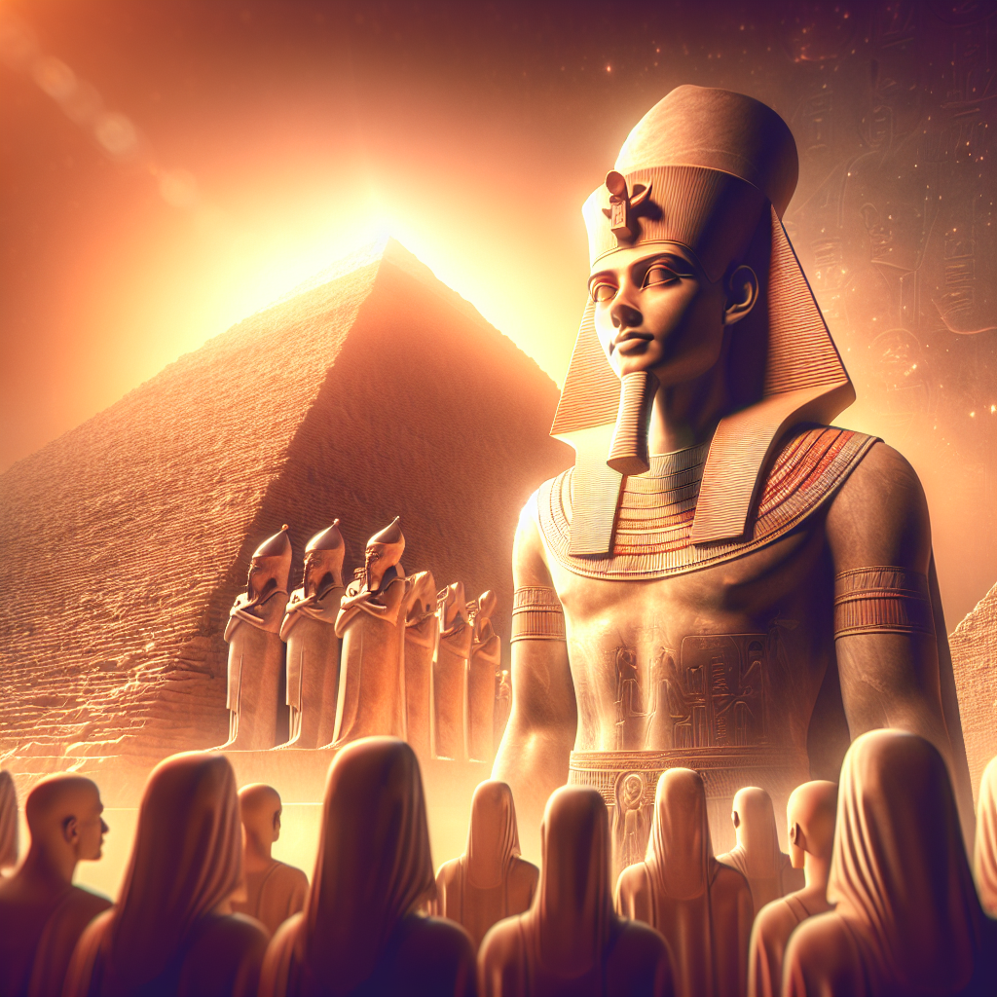
African Sage - Imhotep - Egyptian polymath, architect, physician, adviser - Designed the Step Pyramid, early example of monumental architecture - Later deified for his wisdom and healing abilities
Notes:
Here are suggested teacher notes for this slide: Notes: - Imhotep was an Egyptian polymath who lived around 2600 BC. He was talented in many fields including architecture, medicine, engineering, and advising Pharaohs. - One of Imhotep's major achievements was designing the Step Pyramid of Djoser. This was an early example of monumental stone architecture. Highlight that it preceded the more famous pyramids at Giza by many centuries. - Imhotep was later deified by Egyptians for his wisdom as a physician and healer. He contributed medical innovations and treated diseases. He became associated with the Egyptian god of medicine and healing. Relevant exercises: - Have students research and present on another example of early monumental architecture from a different ancient civilization. Compare and contrast with Imhotep's architectural achievements. - Ask students to find examples in modern medicine of conditions, diseases or anatomy named after historically important physician pioneers. Relate this practice back to Imhotep's legacy.

Slide 6
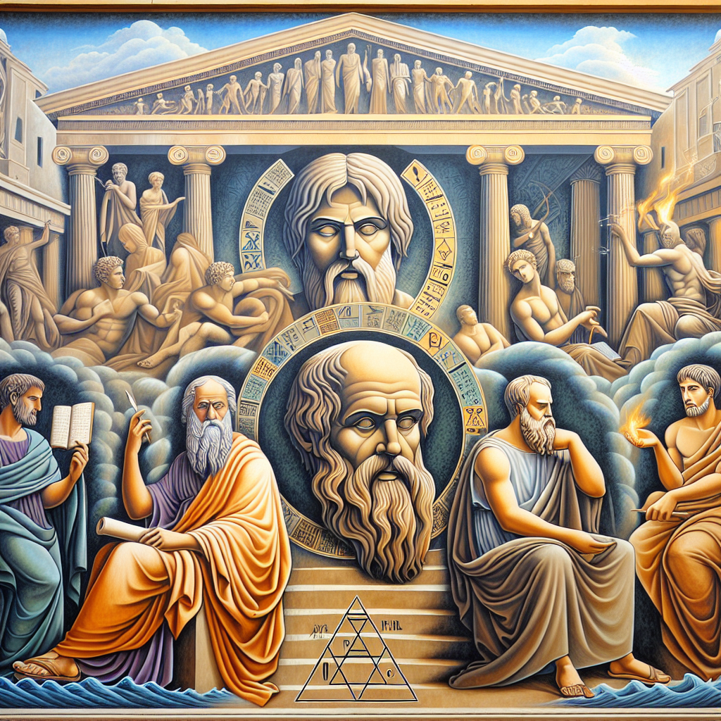
Greek Sages - Pythagoras - mathematician, discovered numerical relationships - Heraclitus - saw world as constantly changing, "can't step in same river twice" - Socrates - questioned assumptions through dialogue and reason - Plato, Aristotle - searched for truth through reason and inquiry
Notes:
Here are some suggested teacher notes for the slide on Greek Sages: Key figures: - Pythagoras: Emphasize his mathematical discoveries and numerical relationships. Have students think of other examples of math patterns they see in the world. - Heraclitus: His quote about not stepping in the same river twice can introduce idea of constancy and change. Ask students for other examples of things that stay the same and things that change. - Socrates: His questioning methods laid the foundation for critical thinking. Consider a class debate where students question assumptions. - Plato and Aristotle: These philosophers used reason and inquiry to search for truth. What truths do students think they know? How could those be questioned and examined?

